Slide 1




LTI Basics and Tsugi
Charles R. Severance
University of Michigan School of Information

Slide 2
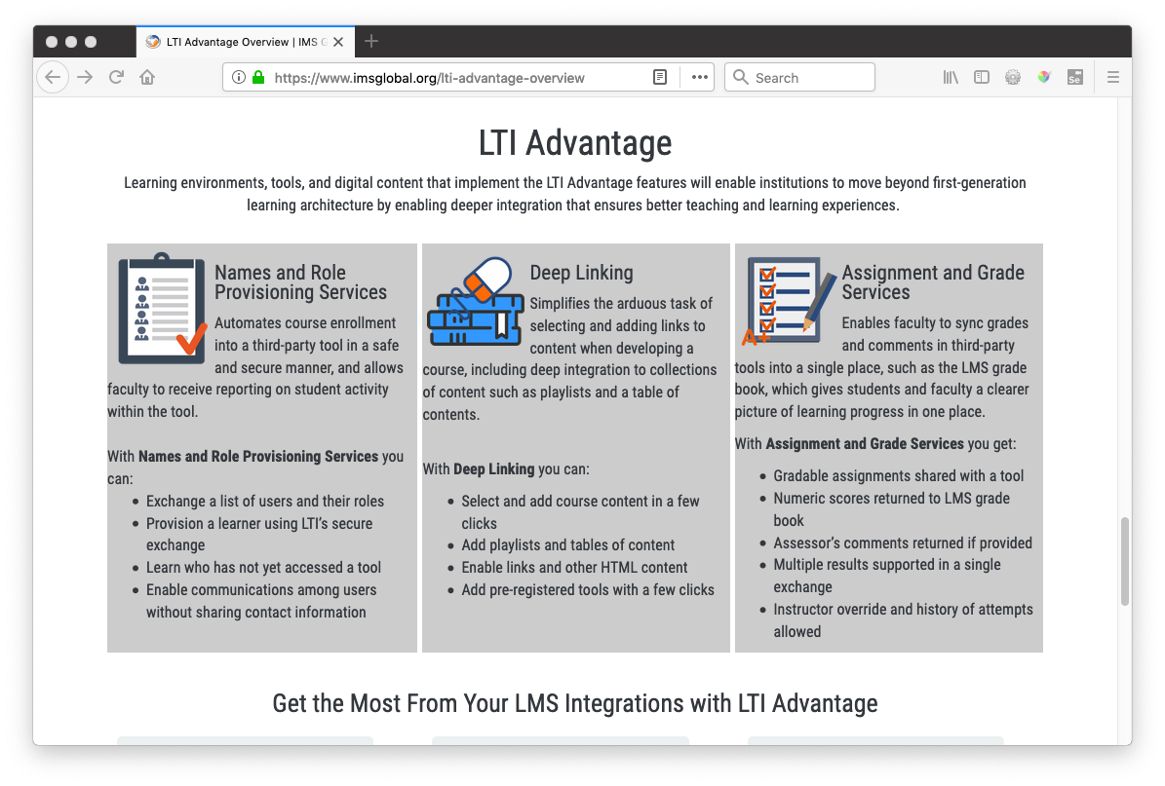

Slide 3
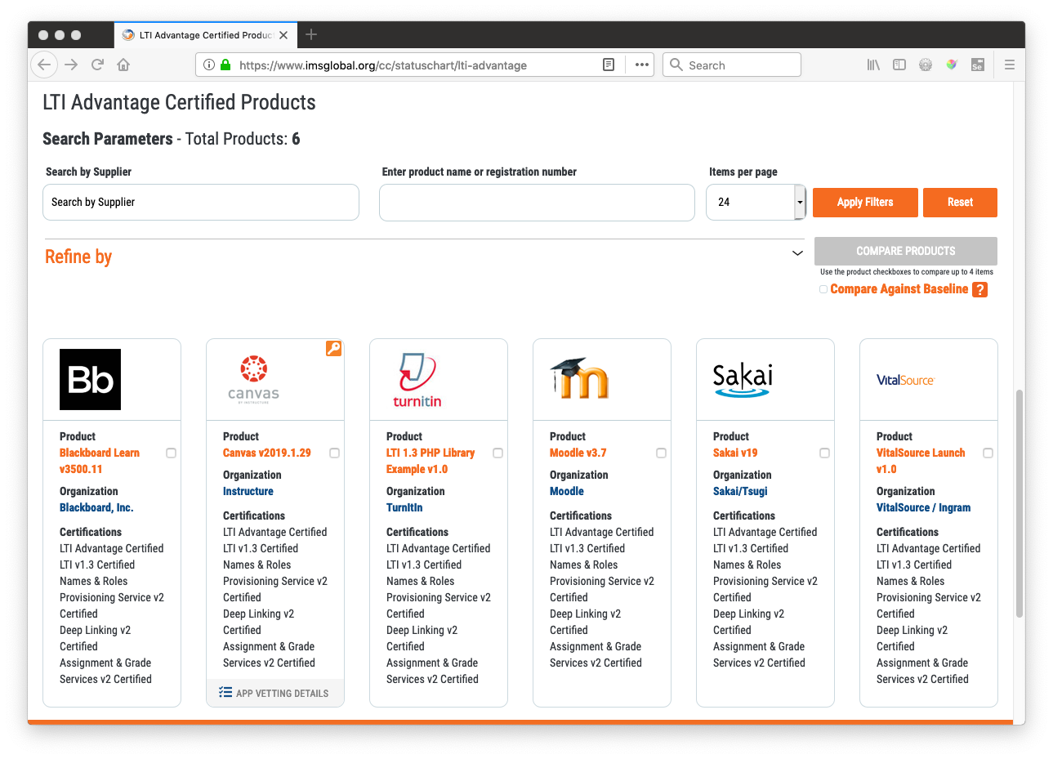

Slide 4
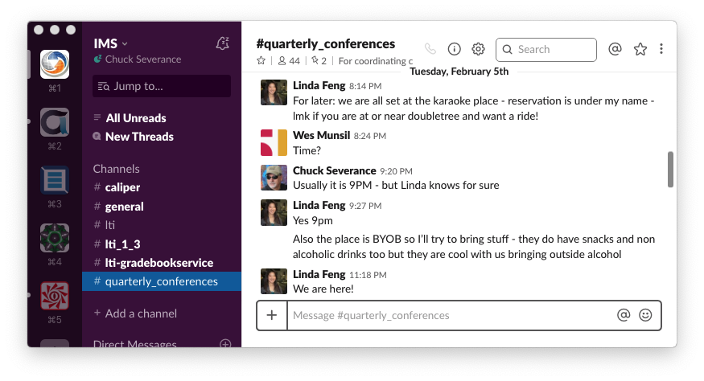

Slide 5
LTI Advantage Technology
New Java Web Token / OpenID Connect / PKI launch – LTI 1.3
LTI 1.3 Launch
Deep Linking Launch (Formerly Content Item)
OAuth 2.0 Services
Auto-created grade column (like LTI 1.1)
Members and roles (roster service)
Outcomes Service (tools can make new columns in the gradebook)
Unprecedented effort to simultaneously release by the "big five" LMS vendors

Slide 6
PKI – Public Private Keys
LTI 1.1 Used a shared secret for launches and services
LTI Advantage uses a pair of Public/Private keys for each message flow
Encoded in a JSON Web Token – JWT
A serialization and signing pattern for exchanging structured JSON

Slide 7
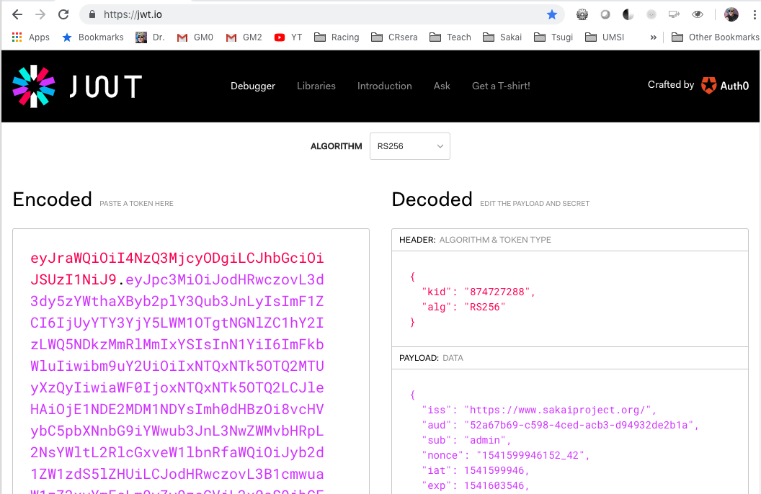

Slide 8
LTI 1.3 / Deep Linking Launch
Platform
Tool
LMS Test
Open ID Connect Initiation
OIDC Initialization
Open ID Connect Response
LTI 1.3 Launch JWT / PKI
Keyset URL
Tool Redirect Endpoint
Browser
Target_link_uri

Slide 9
LTI 1.3 Launch
JSON "claims" in a Java Web Token signed with a public key
LMS (Platform) has a private key and shares the public key widely
Key rotation is possible using kid
Java Web Tokens
Like the LTI 1.x "base string"
Serialization and signatures

Slide 10
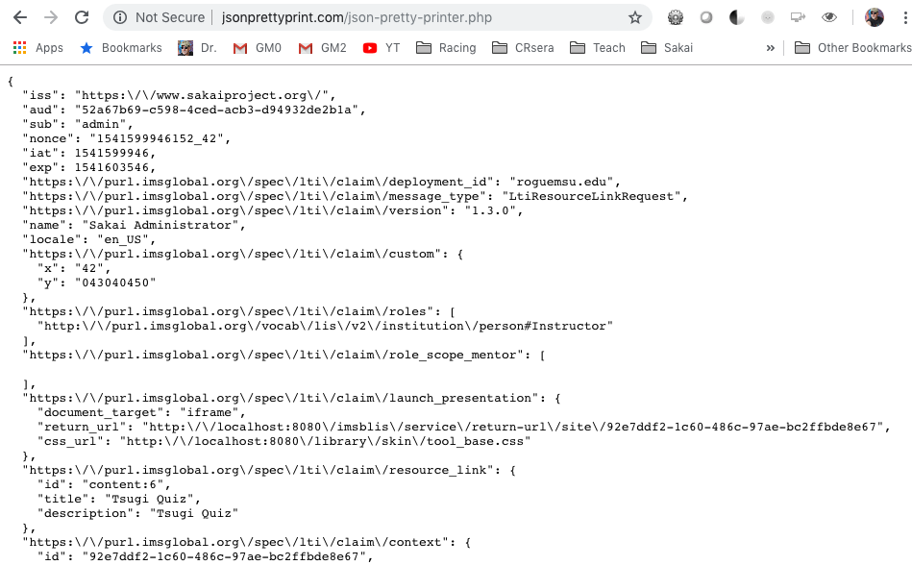

Slide 11
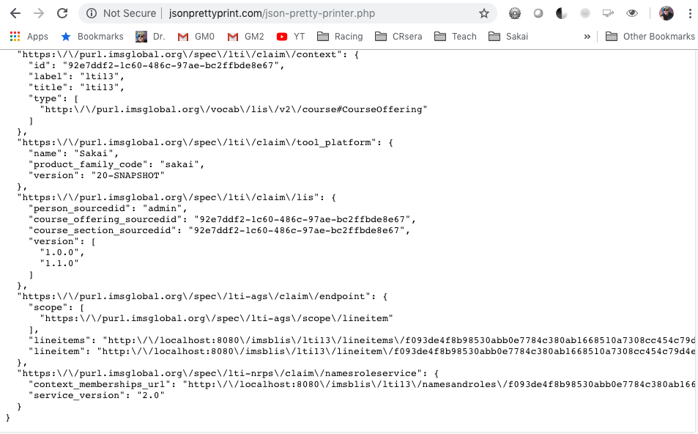

Slide 12
Deep Linking Flow
Platform
Tool
App Store
Open ID Connect
LTI 1.3 Launch JWT
Keyset URL
OIDC Init / Login
Browser
Deep Link Endpoint
Choose App/ Resource
target_link_uri
Click Here

Slide 13
OAuth 2.0 Services
Server to server variant of three legged SSO
Tool has a private key and shares its public key with the LMS
Tool uses message signed with public key to request a "short-lived" token – API token is with API calls to services
When the token expires (an hour usually) the tool must re-request
Tokens have "scopes" – like an AUTHZ grant
Excellent library support in Java for OAuth 2.0

Slide 14
Names and Roles / Outcomes Services
Platform
Tool
Token Request JWT / PKI
Token end point
Keyset URL
Token
Token Cache
Token
Service
Token
Service
Token
Service

Slide 15
Observations
Great cooperation between and amongst LMS vendors and Tool Vendors – this was essential to the success of LTI Advantage
There will be a lot of pressure from LMS Vendors
Away from proprietary LMS APIs where LTI Advantage is sufficient
Away from LTI 1.1
Good news and bad news
The basics of LTI Advantage is surprisingly easy when you have sample code
There will be a lot of lousy LTI Advantage Tool implementations (ad for Tsugi)
SASSifying of the commercial LMS vendors is a complicating factor

Slide 16
Rapid Educational Tool Development Using Tsugi
www.tsugi.org

Slide 17








IMS LTI Advantage® IMS Deep Linking® IMS Common Cartridge®
次Tsugi

Slide 18
What is Tsugi?
Learning Application Development Framework
Standards Compliance / LMS Integration Libraries
Learning App Store
Hosting / Hosted services for Tools
Koseu
DIY Publishing
Learning Object Repository
MOOC Hosting Platform

Slide 19
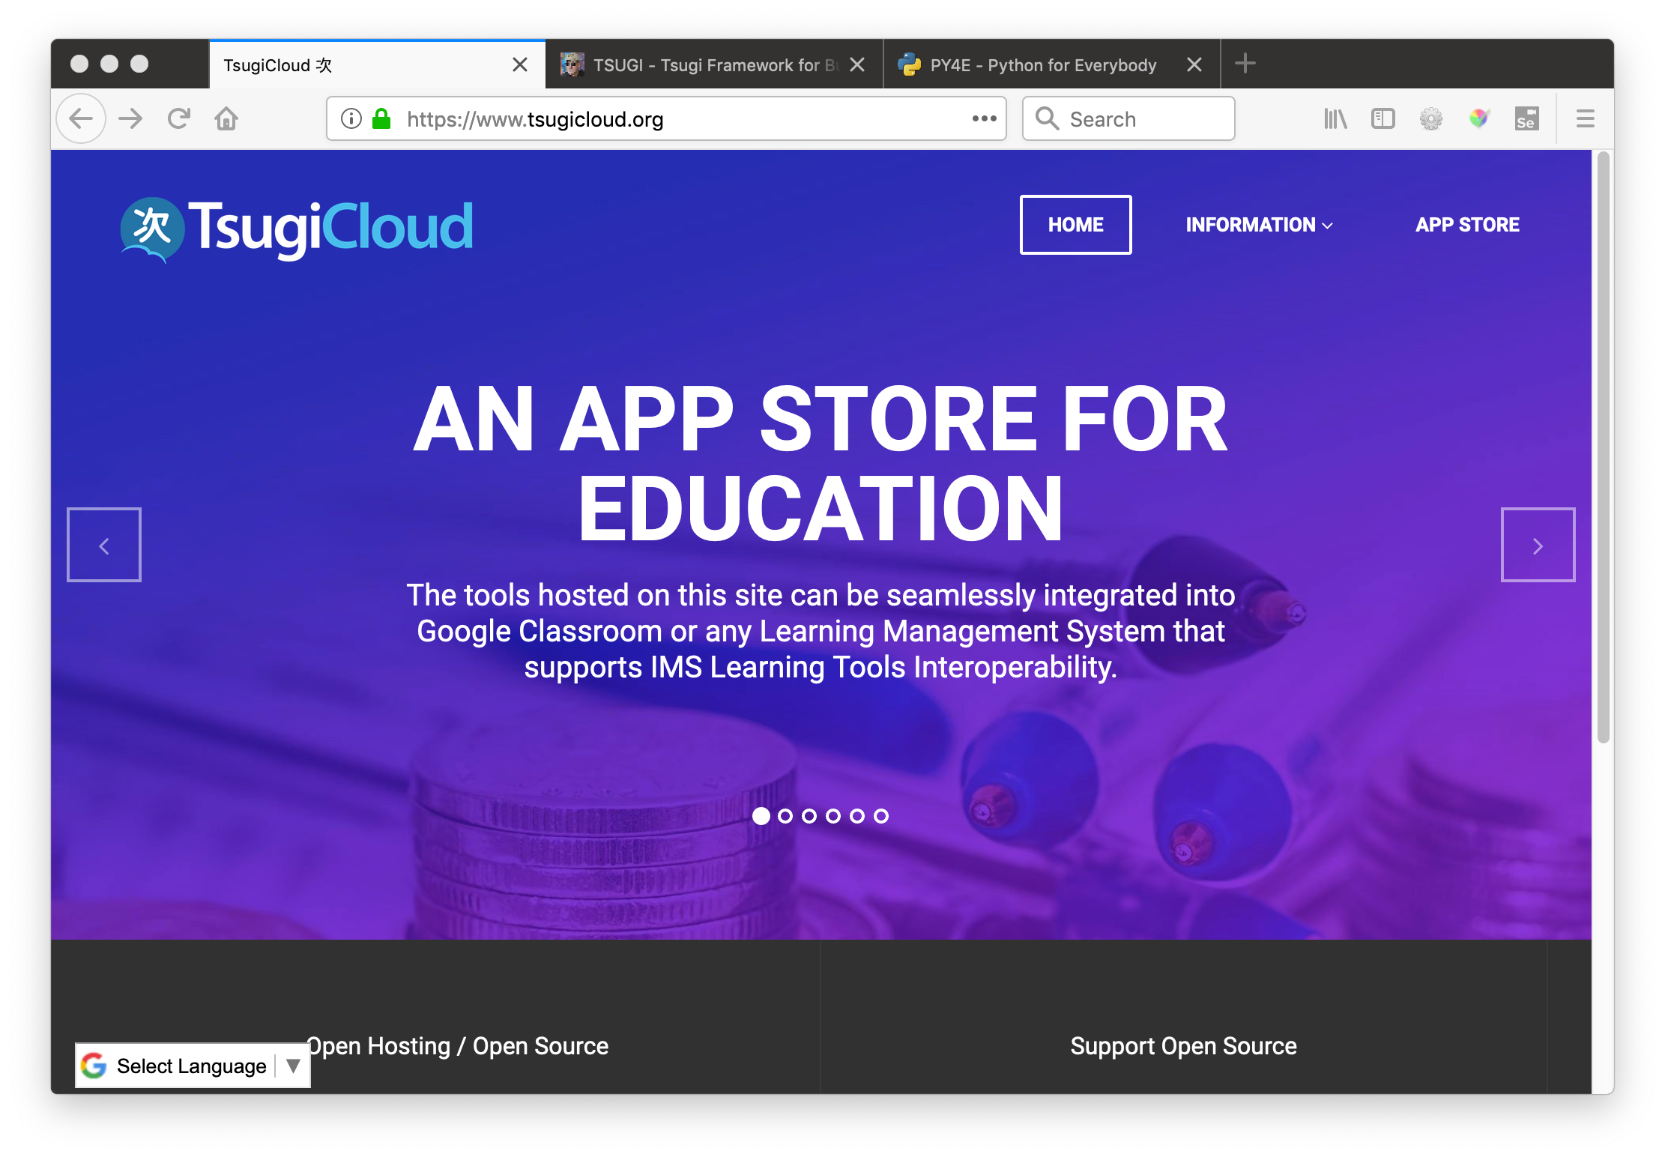

Slide 20
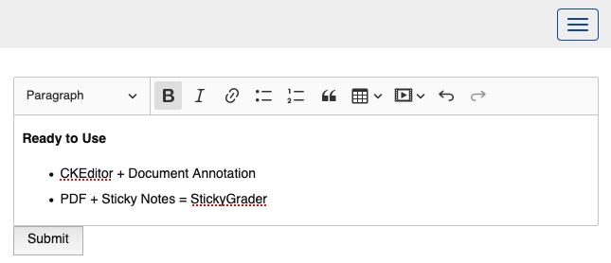
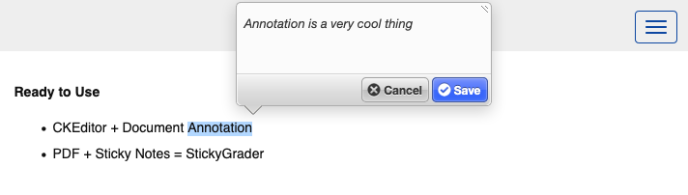
https://www.tsugicloud.org/tsugi/store/details/ckpaper

Slide 21
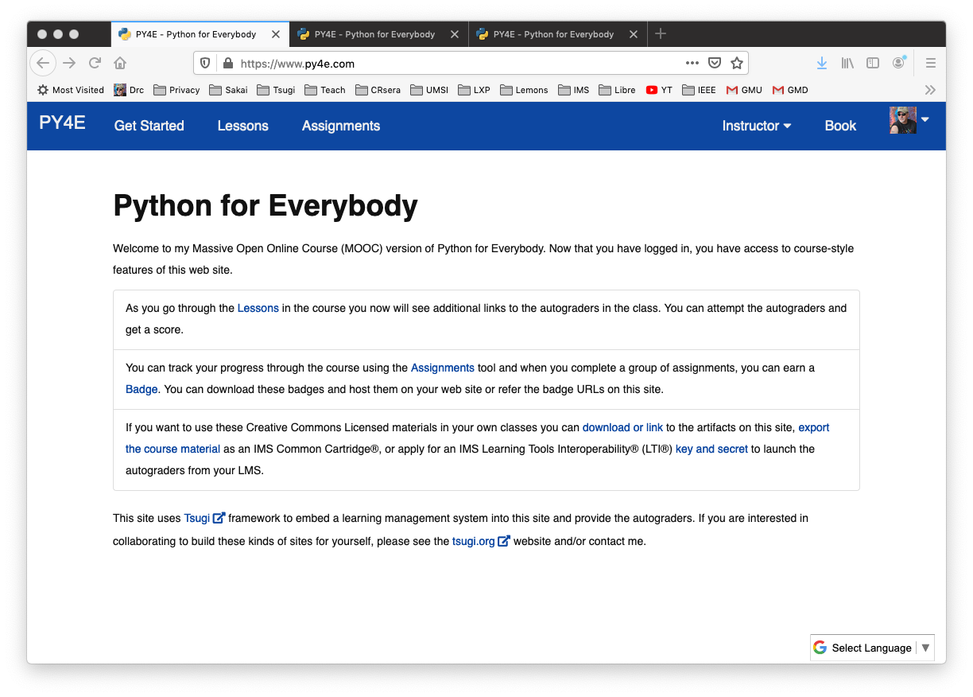
Koseu
Learning Object Repository and Learning Platform

Slide 22
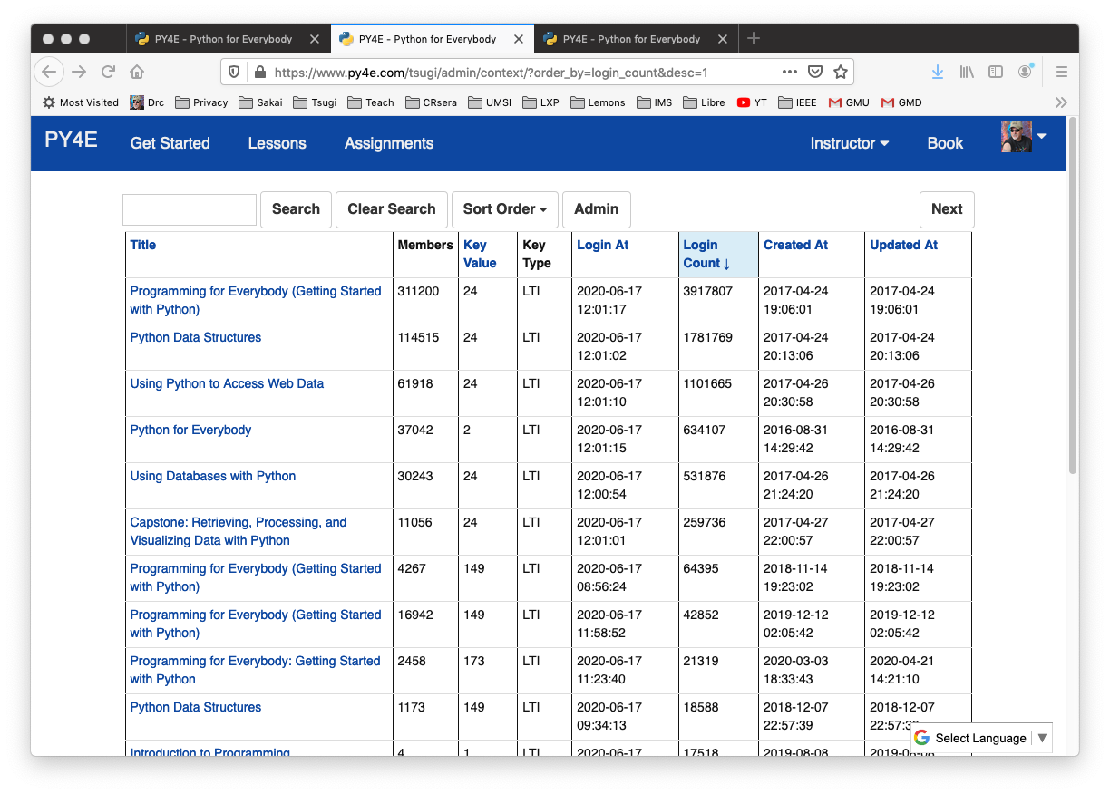
Performance and Scale

Slide 23
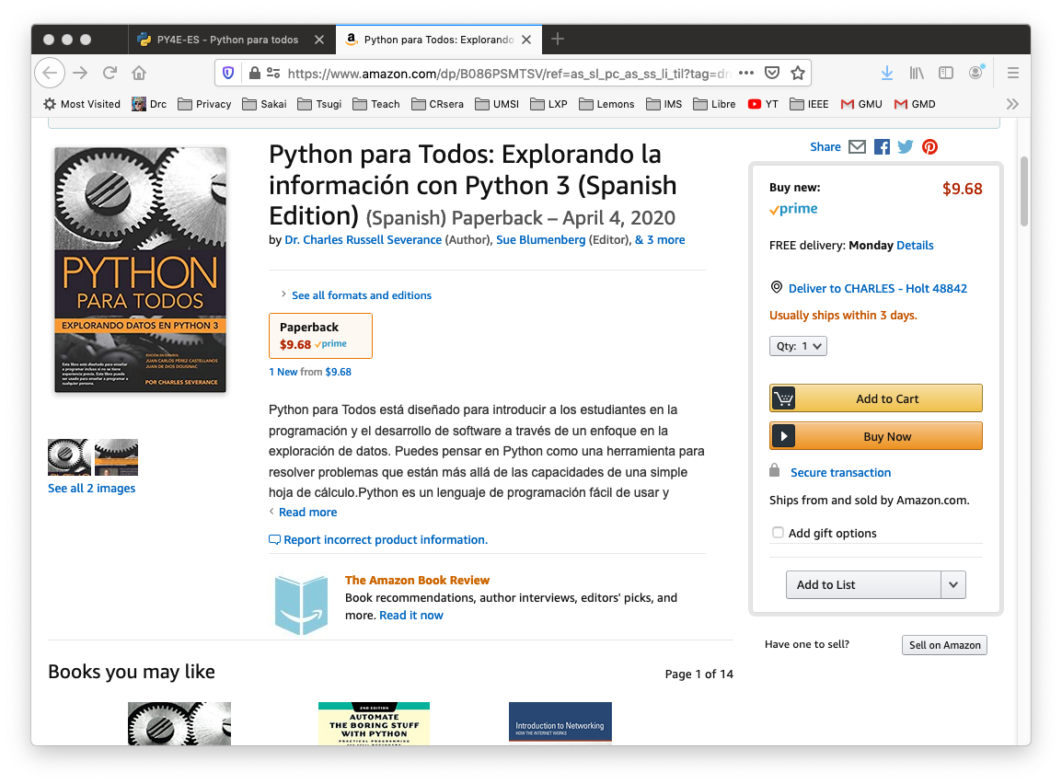
Koseu DIY Publisher

Slide 24



TODO: Make Publisher Back End Usable
LTI Apps
Pages
Files
Graders
Book
LOR/MOOC py4e.com
Autograders (次)
Modules
OER Content (코스)
IMS
Canvas
edX
Pandoc
Coursera
KDP
Media
FutureLearn
archive.org
YouTube
Amazon
ITunes
Google Play

Slide 25
References
Web Site - https://github.com/tsugiproject/tsugi-org
Tsugi UI - https://github.com/tsugiproject/tsugi
Tsugi PHP Library - https://github.com/tsugiproject/tsugi-php
Tsugi Hosting - https://github.com/tsugiproject/tsugi-build
Koseu – LMS / Learning Object Repository
Python for Everybody - https://github.com/csev/py4e
Web Applications for Everybody - https://github.com/csev/wa4e

